Slide 1


C.G.P.A
DEVISER
A Mini Java Project
Mohan D
1BM19IS092
Moksh Jayanth G R
1BM19IS094
Java Faculty:
Mamatha M

Slide 2
Introduction
CGPA is defined as Cumulative Grade Points Average which is the sum total of the SGPA's of all semesters or that of an academic year. SGPA, on the other hand, are the grades obtained in one semester.
Not only in engineering, CGPA'S are calculated in different types of education courses.
We know Plans make our work easier, every student wish to secure a good CGPA in their academics, so having the plans before hand would assist the student to apply the sufficient amount of efforts required to achieve it.
The plan is all about the SGPAs a student has to aim and score in each semester in order to achieve the desired CGPA.

Slide 3


PROBLEM STATEMENT
C.G.P.A Deviser
The Software's functionality is classified into two parts:
The software calculates S.G.P.A of the student and outputs the final SEE and CIE marks into a file in a proper tabulated manner.
Based on the 'target C.G.P.A' entered by the student, the software formulates several possible plans to achieve the target C.G.P.A of the student. Then the software prints the plans into a file for future reference.

Slide 4
IMPLEMENTATION
Firstly, the Student's S.G.PA for the current semester is calculated by the software based on the CIE And SEE Marks entered by the student.
This feature uses the basic concepts of Java such as classes, objects, constructors etc..
The S.G.P.A along with the CIE and SEE Marks are printed into a text file using files concept of Java.
Then based on the Student's C.G.P.A of the previous semester and the Student's target C.G.P.A, the software formulates several possible plans to achieve the target C.G.P.A by the end of the course.
This feature is implemented by performing the operations on collection frameworks.
All of the formulated plans are again printed into a text file for future reference.

Slide 5
Java concepts used
Basic concepts :
- Classes and Objects
- Constructors (Default and Parameterized Constructors)
- Inheritance
Other concepts :
- Exception handling (RunTime Exception Handling)
- Type Wrappers
- File handling
- String handling
Collection Frameworks and Data structures:
- Arrays
- ArrayList
- Linked HashMap
- Lists
- Sets

Slide 6

Code Editors and IDEs
Used
JGRASP
Visual Studio CODE
Intelli J IDEA

Slide 7

Project Structure
CGPA-Deviser
StudentMarksContainer
CalculateSGPA
Main
Combinations
DataContainer

Slide 8
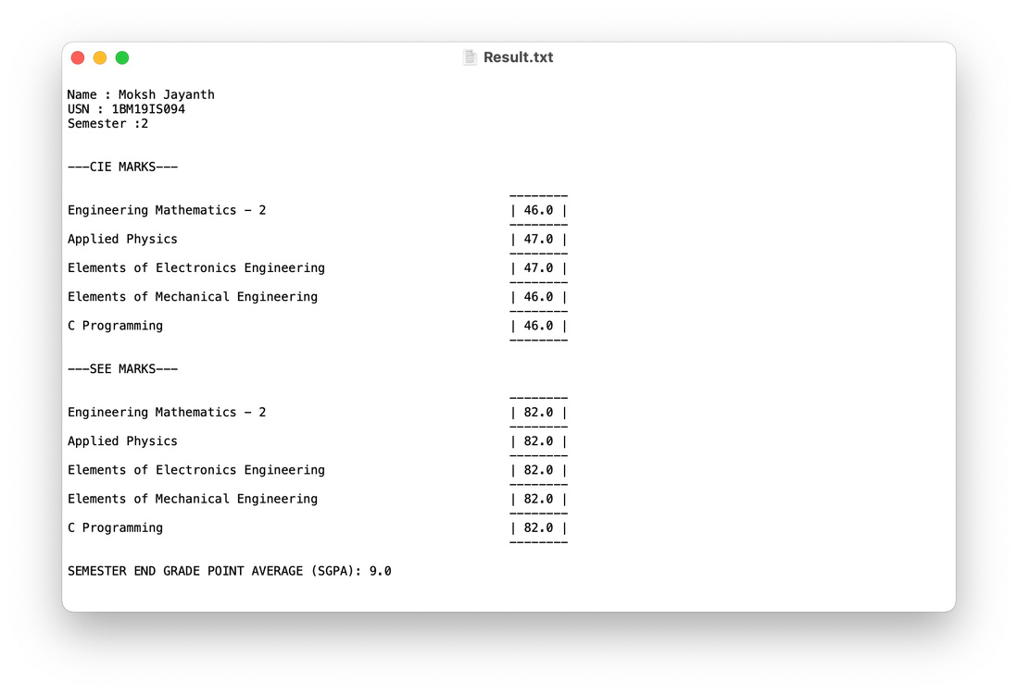
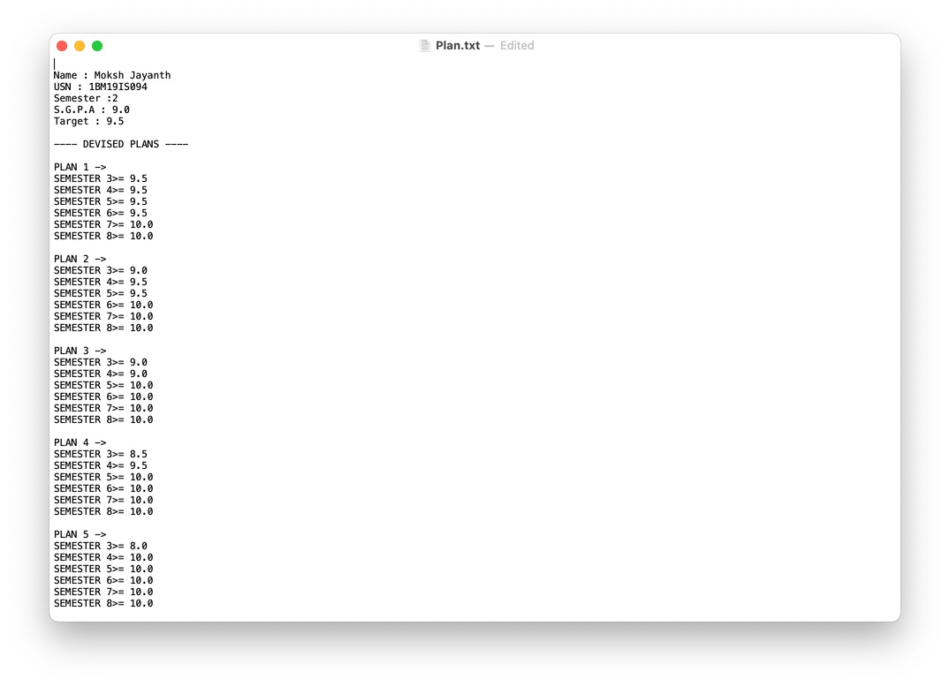
SAMPLE OUTPUTS
Result.txt
Plan.txt

Slide 9


THANK YOU

